Slide 1
Capstone Project
By Anthony Quast

Slide 2
Data
Suburb dataset acquired from matthewproctor.com/australian_postcodes
Dataset contains all Australian postcodes along with their locality, state, latitude and longitude -> scraped for postcodes within 10KM of Melbourne
Venue data acquired from Foursquare database
Skimmed for venues in each suburb by passing a request with the ‘query’ parameter set to ‘gym’

Slide 3
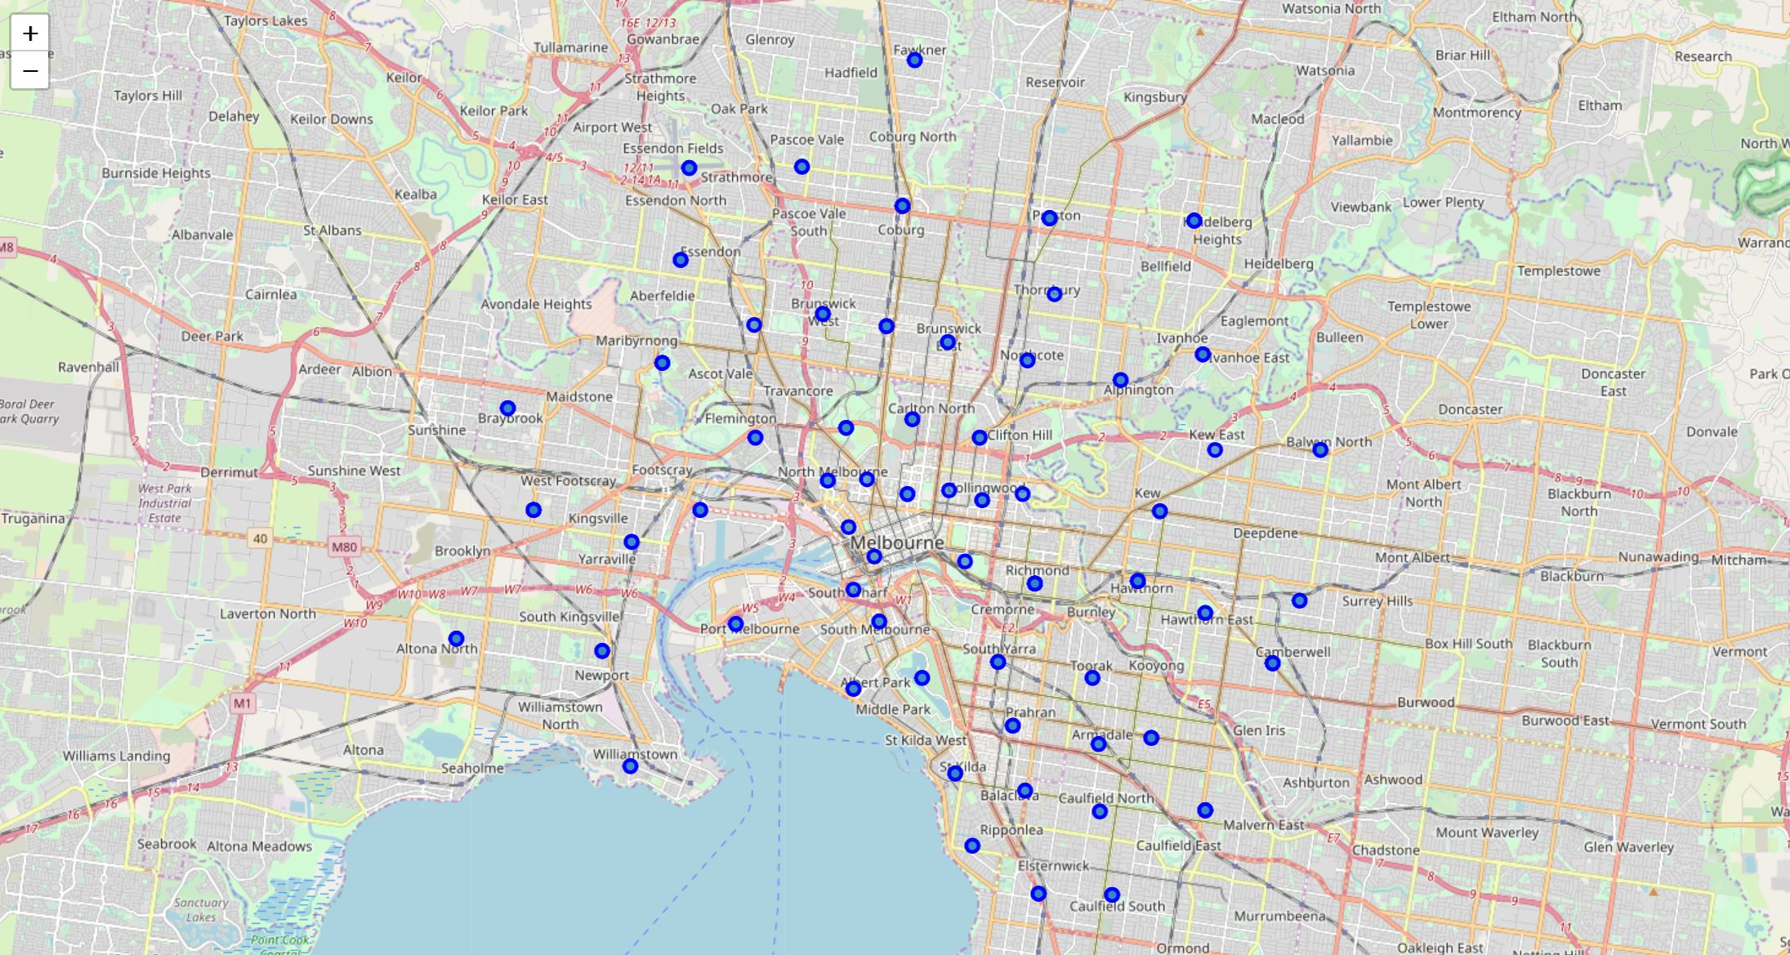
Visualisation of postcodes …within 10km of the city centre

Slide 4
K-means analysis

Slide 5
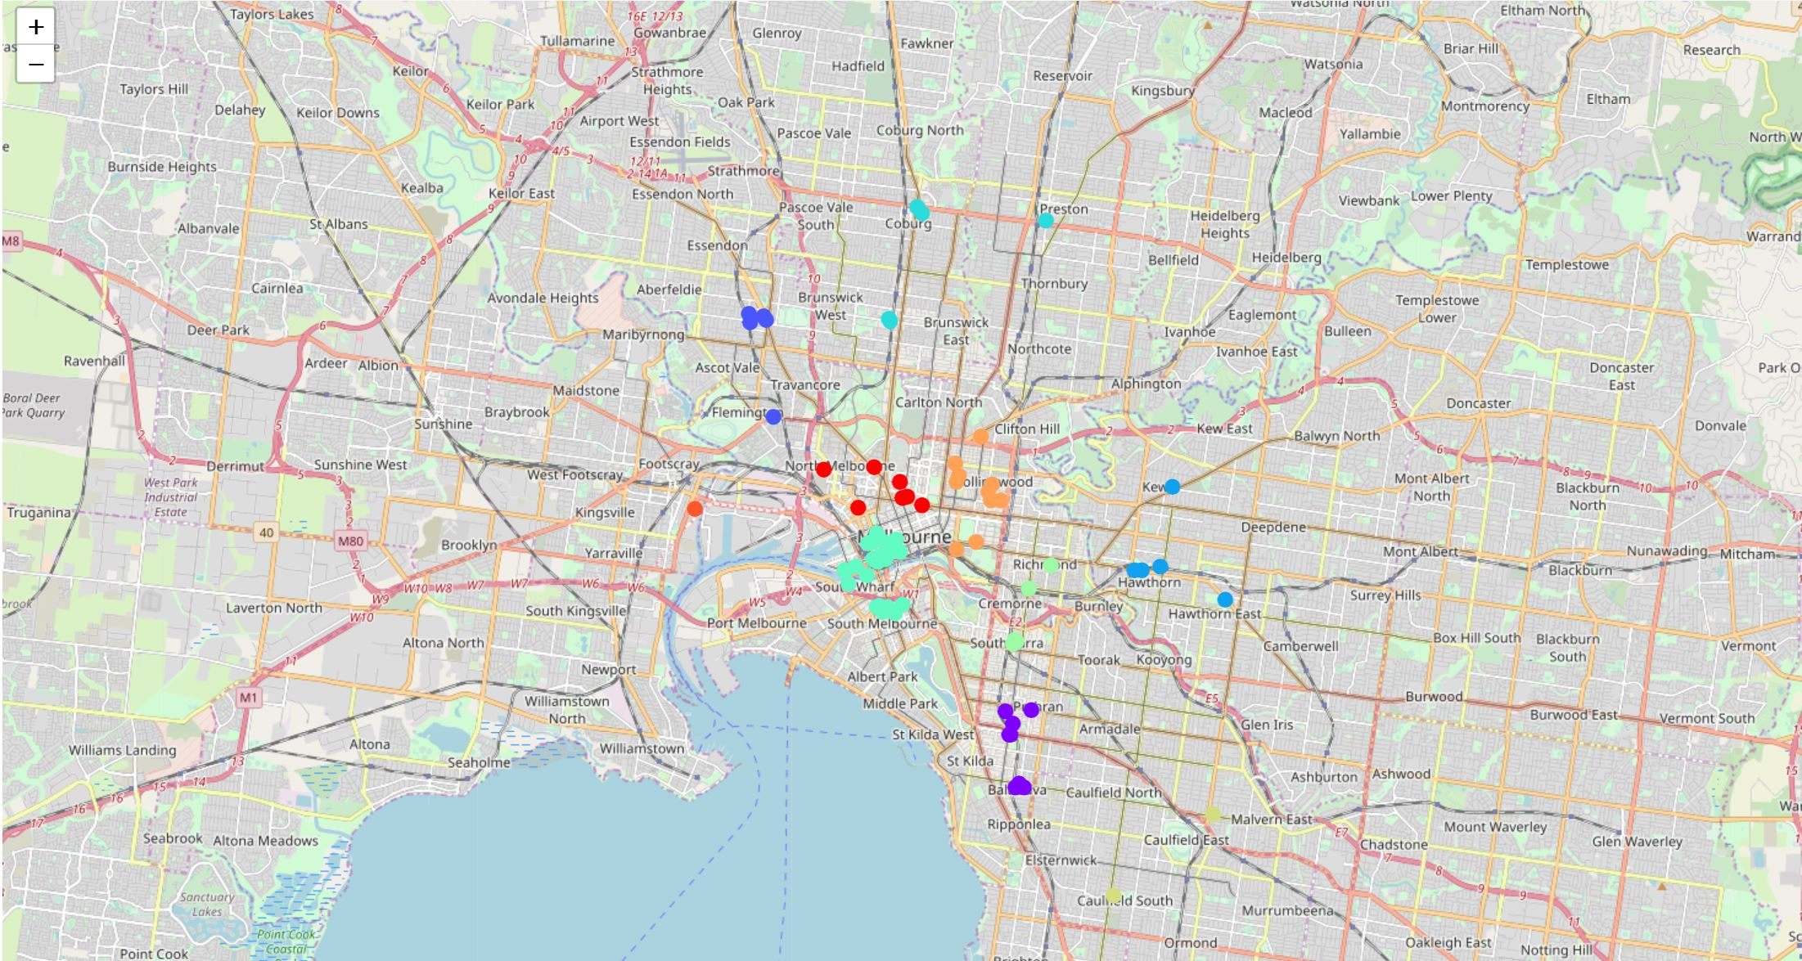
Cluster visualisation

Slide 6
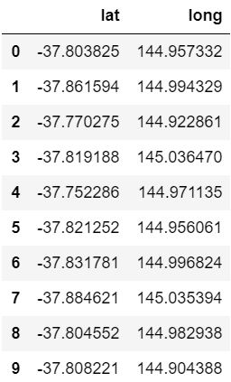
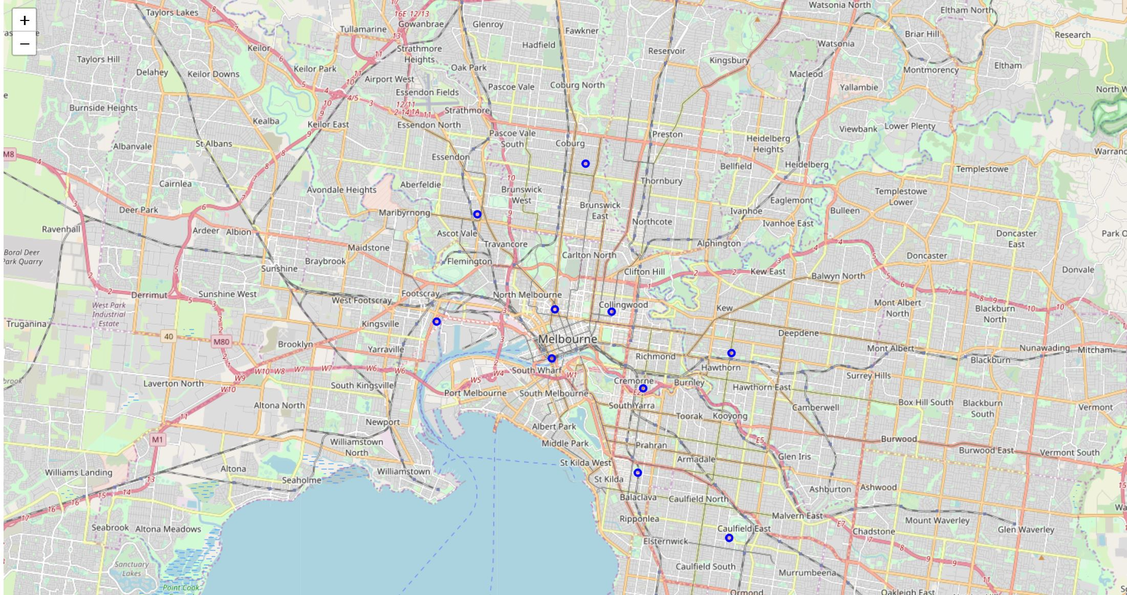
Cluster means

Slide 7
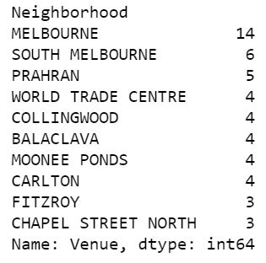
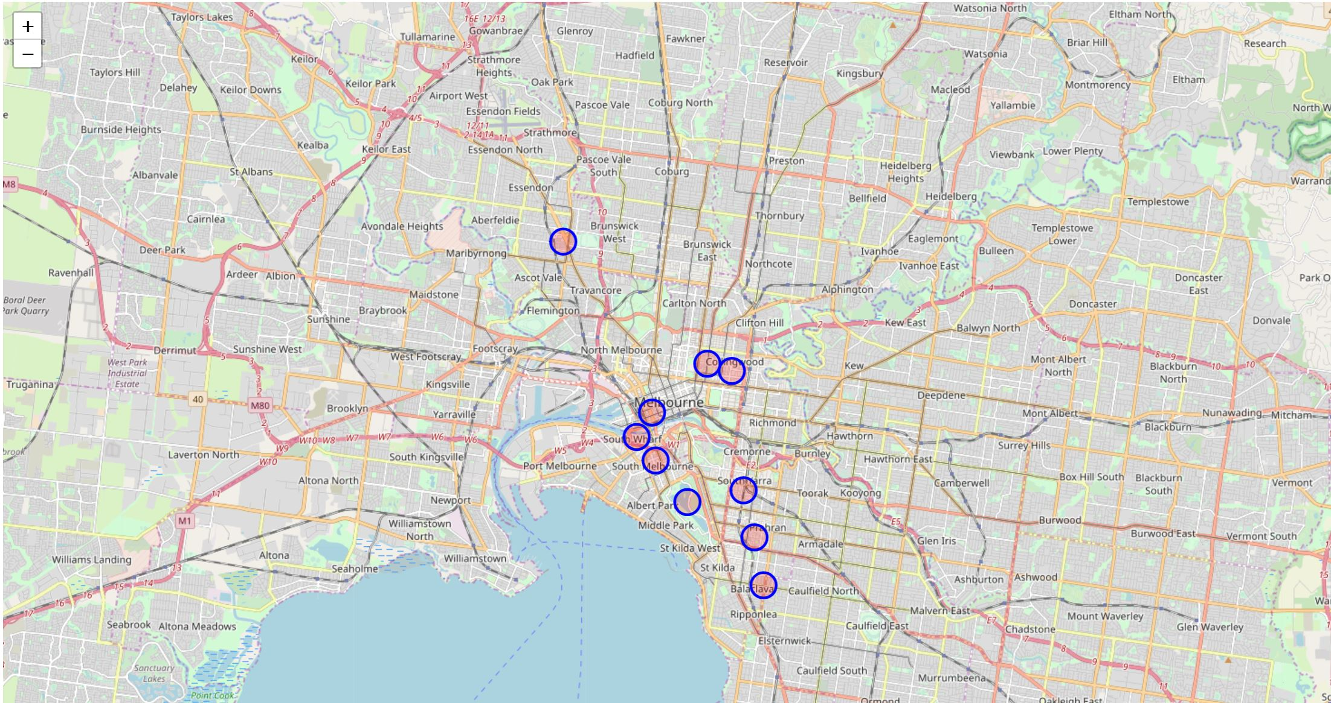
Suburbs with the highest # of venues

Slide 8
Considerations
Limited # of venues analysed
Supplement store competition not considered
% of potential customers differs for each venue
Cost difference between locations not considered
Arbitrary clusters

Slide 9
Conclusions
Central business district most viable location
Should consider revising venue location policy
Most clusters are in close vicinity to CBD
Ascot-vale also a considerable location
Distinct cluster with >8 venues in vicinity
Further analysis needed for more suggestions

